Slide 1
Text Search Engine
何其睿Steven
张世辰Harry
魏焕哲William
1830026032
1830026154
1830026116

Slide 2
CONTENTS
01.Data collection
02.Indexing and ranking
03.Searching Interface
04.Demonstration

Slide 3
PART 01
Data Collection

Slide 4
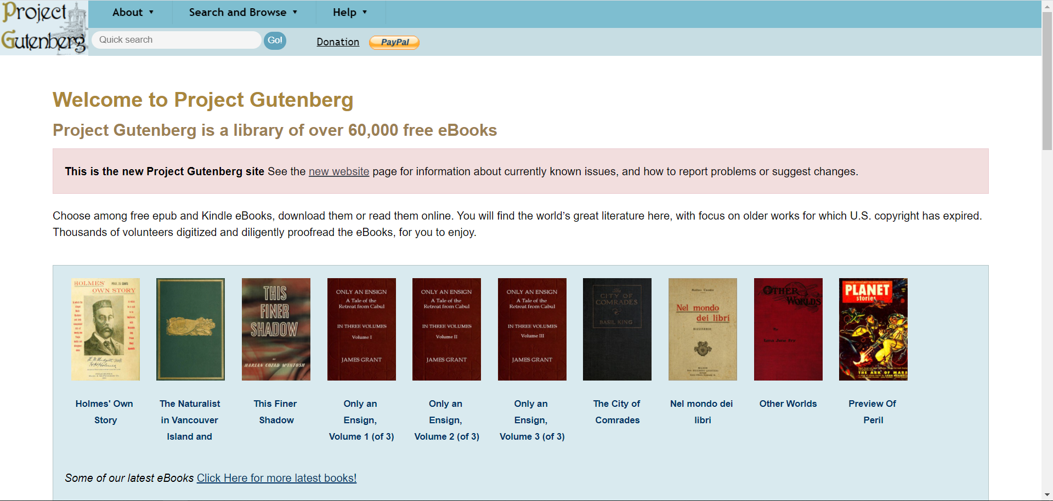
Data Collection
www.gutenberg.org
A library of over 60,000 free eBooks.

Slide 5
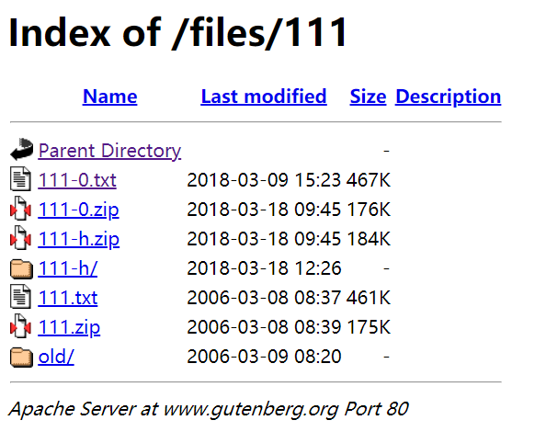
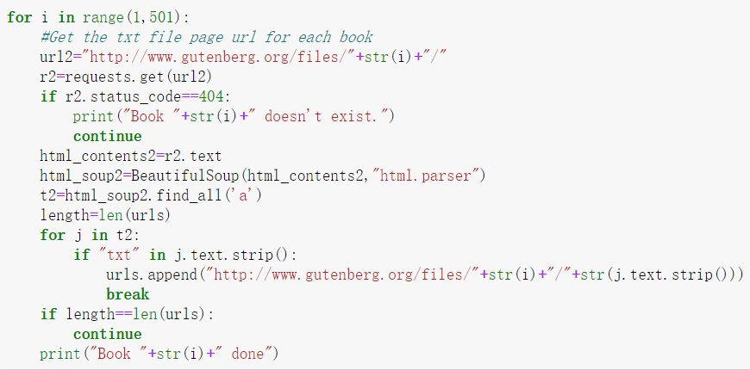
Data Collection
Find the webpages that contain the text content
01

Slide 6
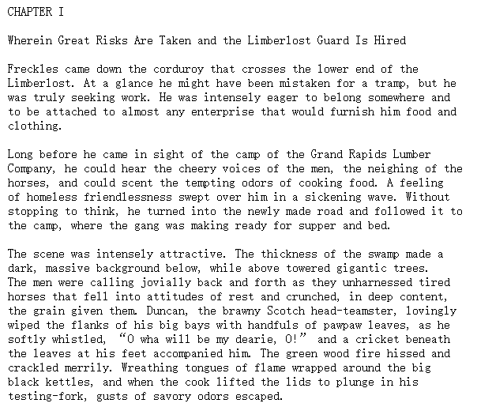
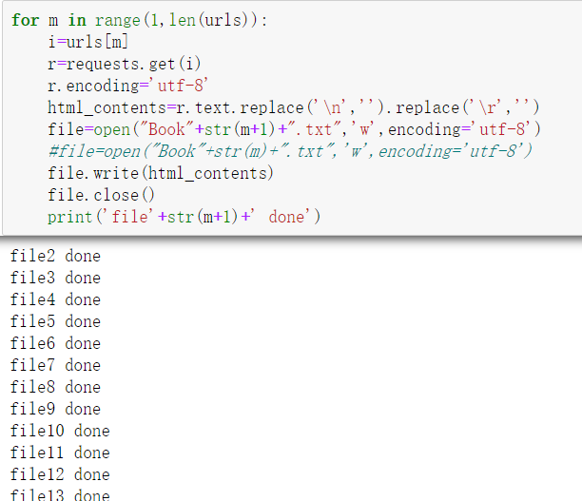
Data Collection
Get the text content of each webpage
02

Slide 7
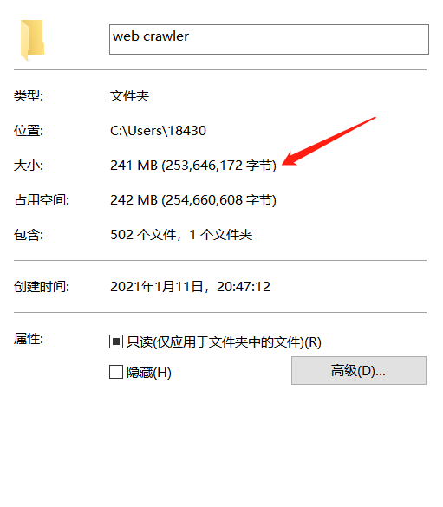
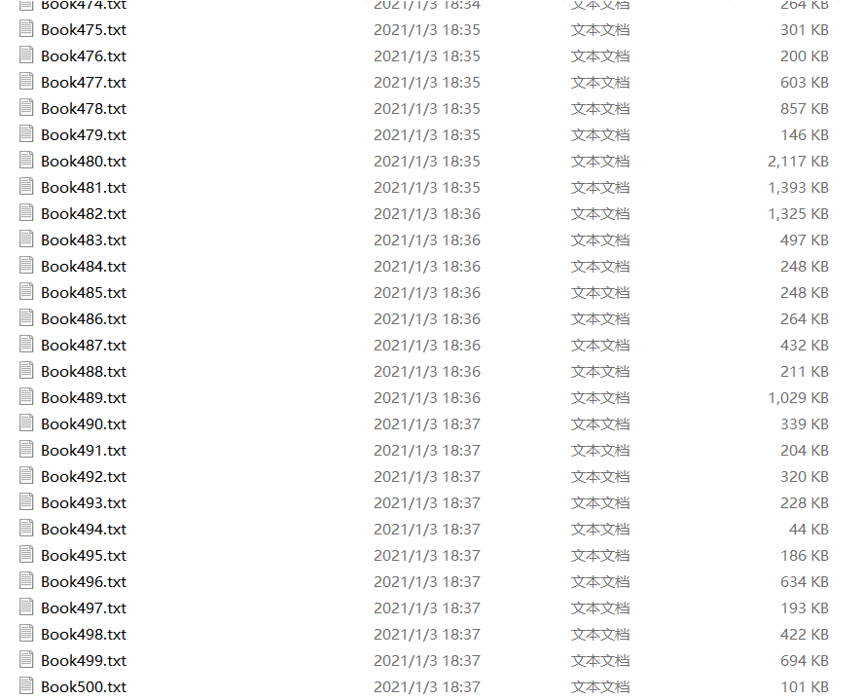
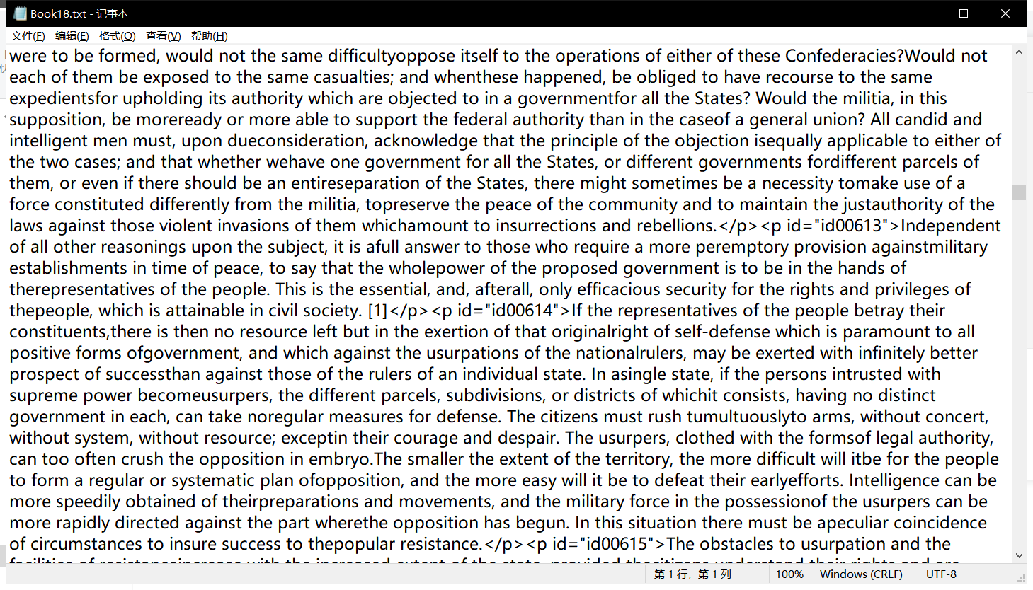
Data Collection

Slide 8
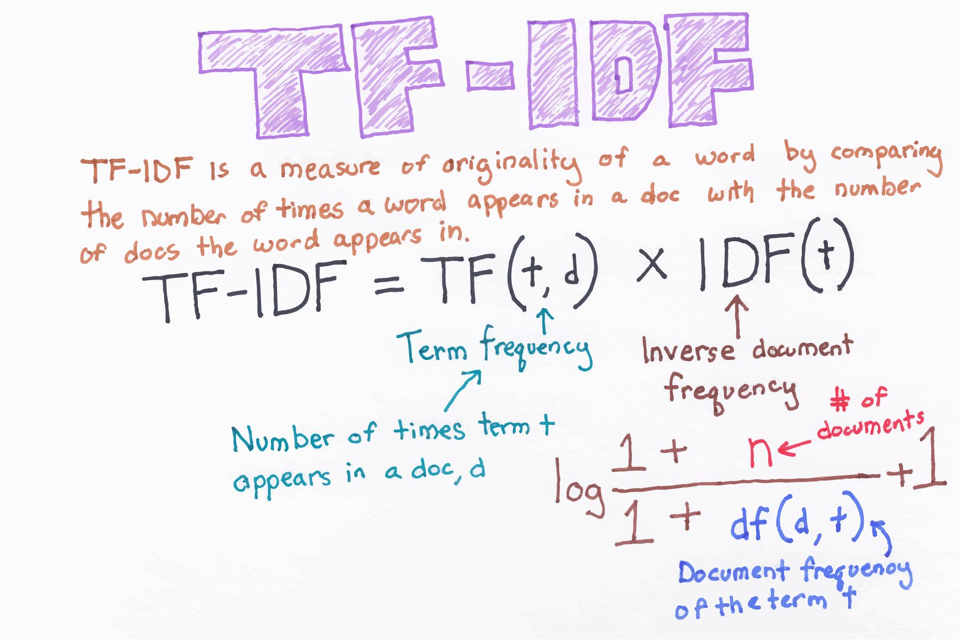
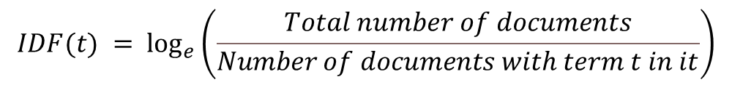
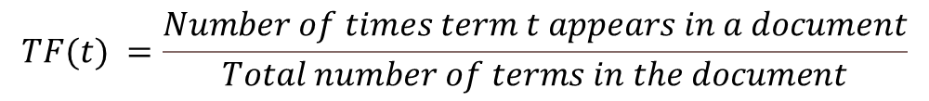
Ranking Algorithm
$$TF(t) =\frac{Number of times term t appears in a document}{Total number of terms in the document}$$
$$IDF(t) = \log_{e}\left(\frac{Total number of documents}{Number of documents with term t in it}\right)$$

Slide 9
PART 02
Indexing and ranking

Slide 10
Indexing and ranking
Indexing using Hadoop MapReduce
Indexing in a single computer by Java
Comparing the time of the Indexing
Add ranking part to Inverted Index
01
03
02
04

Slide 11
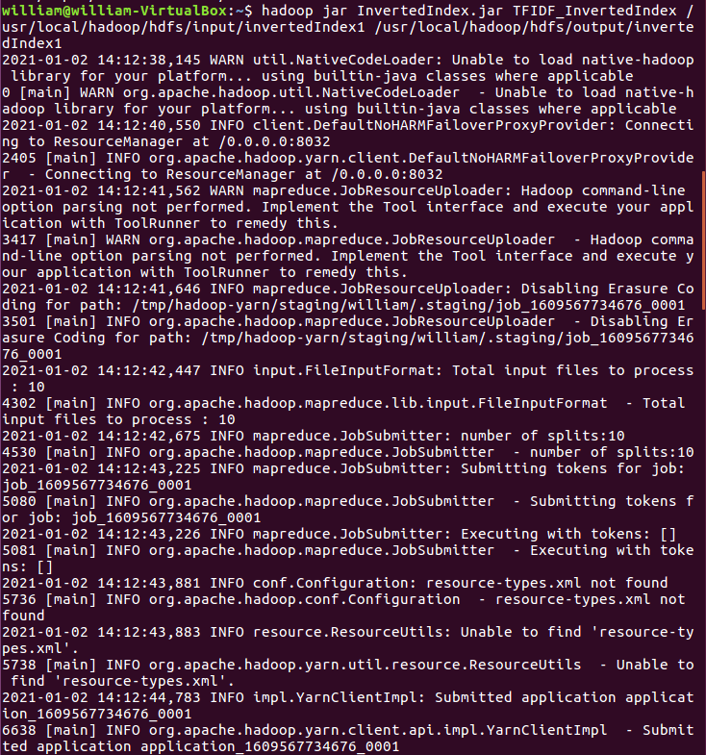
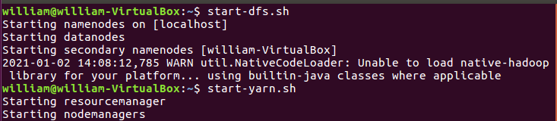
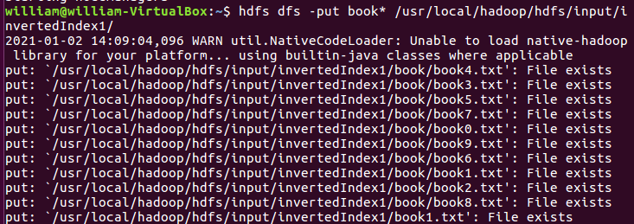
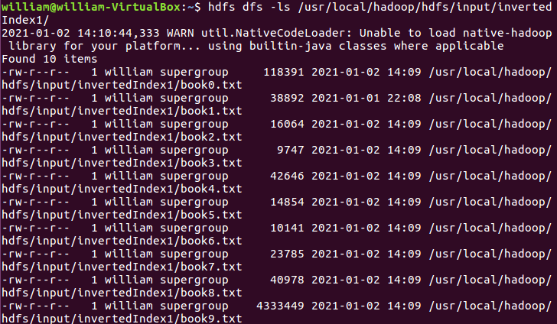
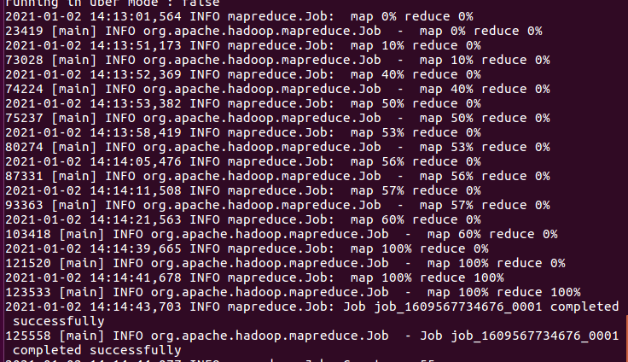
Inverted Indexing <10m
On Hadoop MapReduce

Slide 12
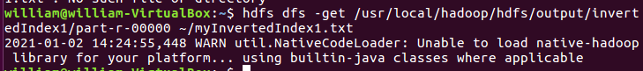
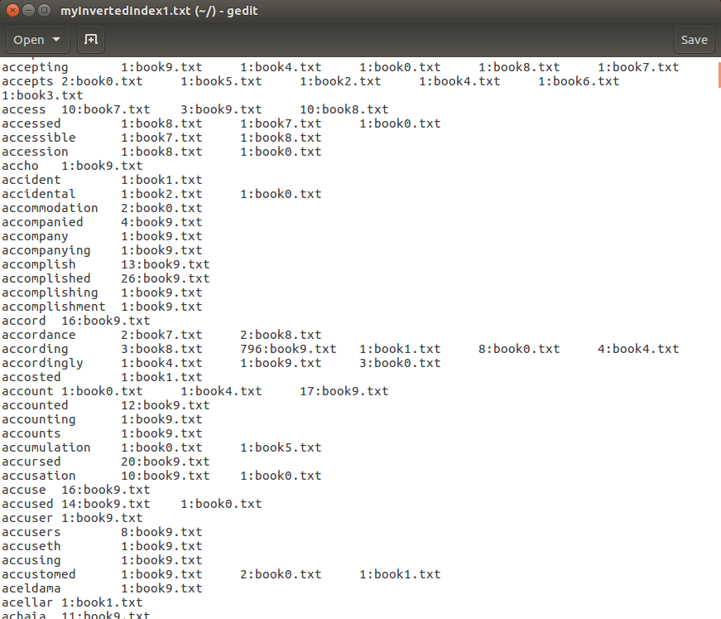
Inverted Indexing <10m
On Hadoop MapReduce

Slide 13
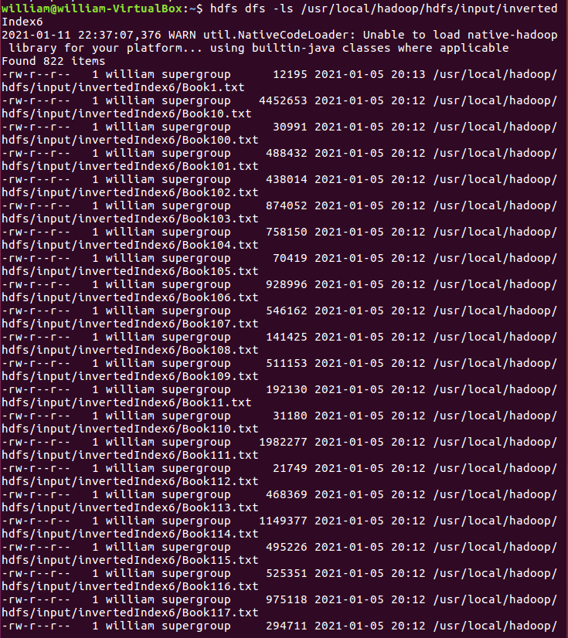
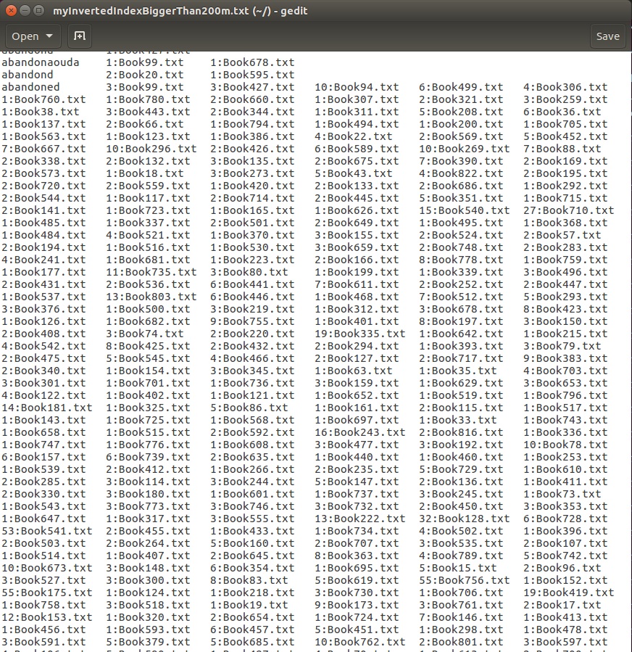
Inverted Indexing >200m
On Hadoop MapReduce

Slide 14
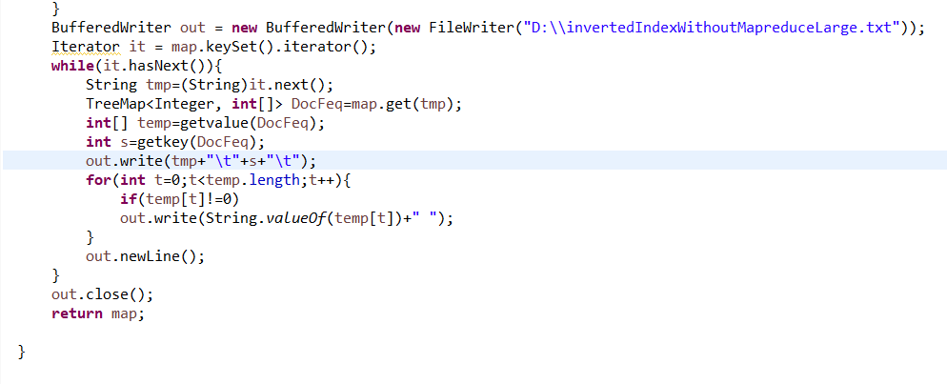
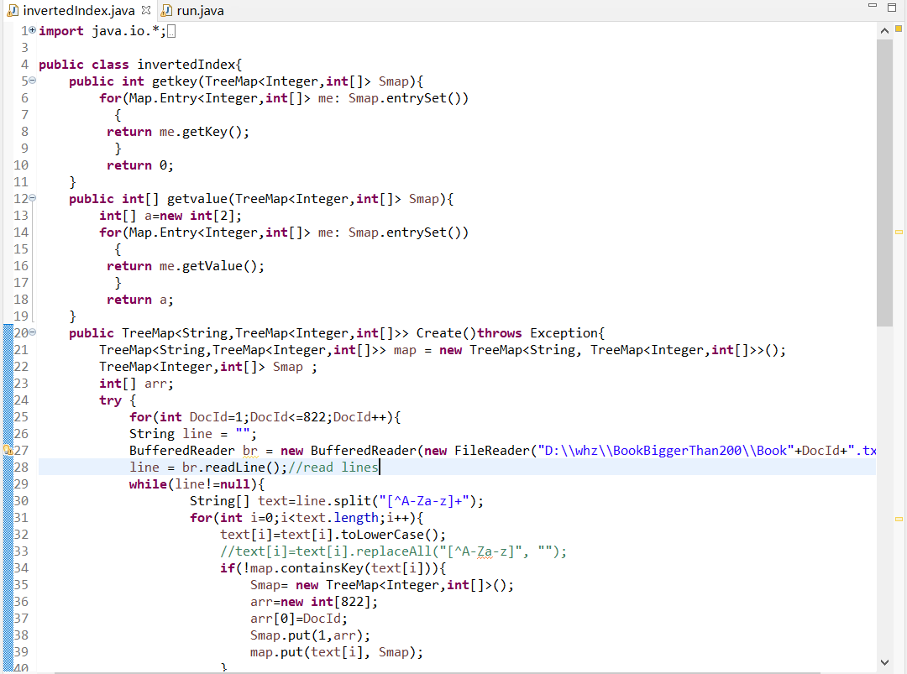
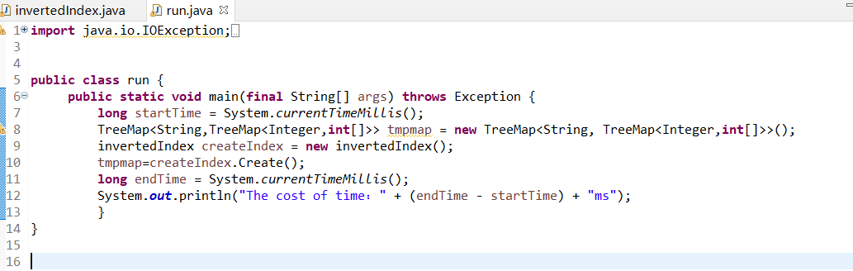
Indexing <10m and 200m
Running in a single computer using Java
Code construction:
invertedIndex.java(build HashMap to produce dictionary Index.dict)
run.java (main function)

Slide 15
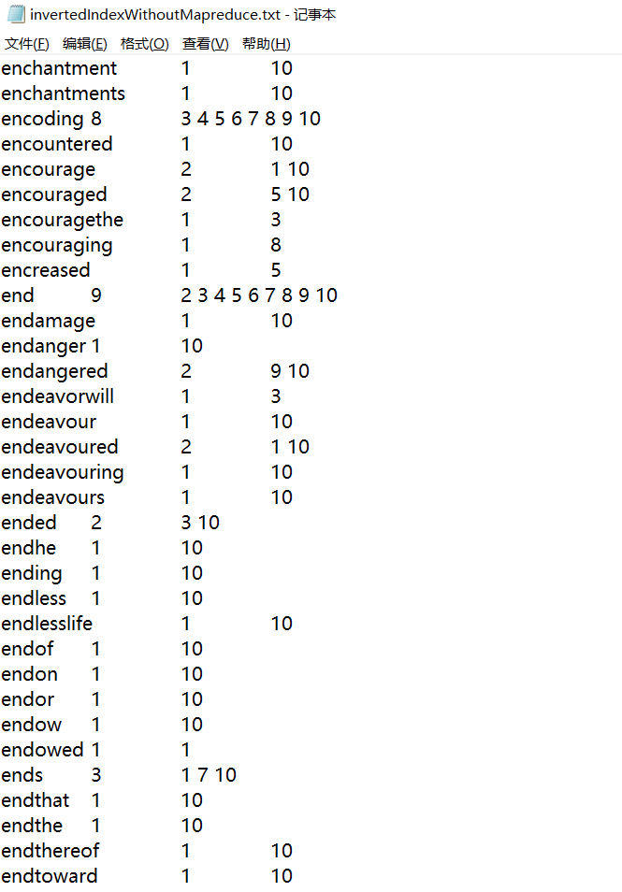
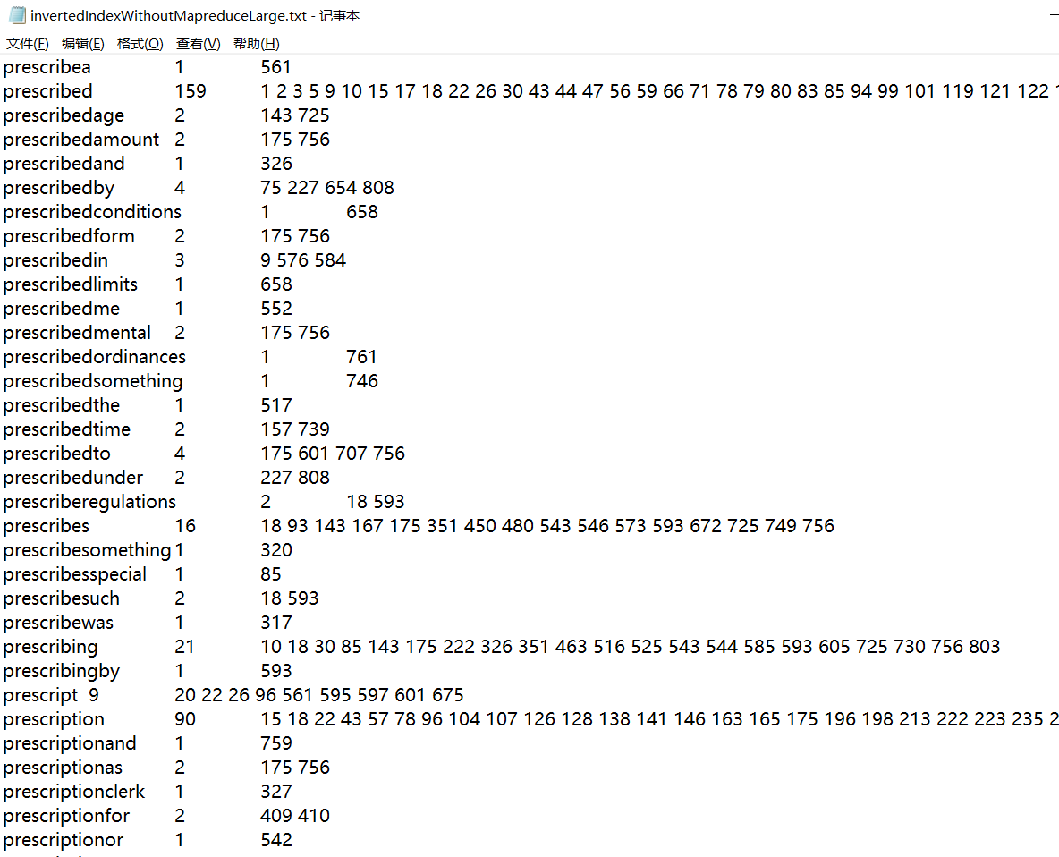
Indexing <10m and >200m
Running results without MapReduce

Slide 16
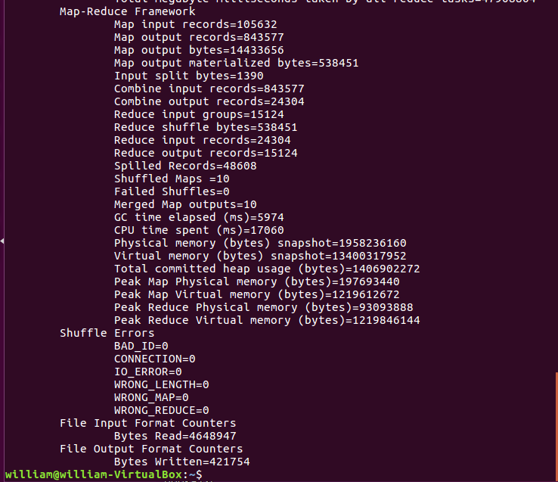
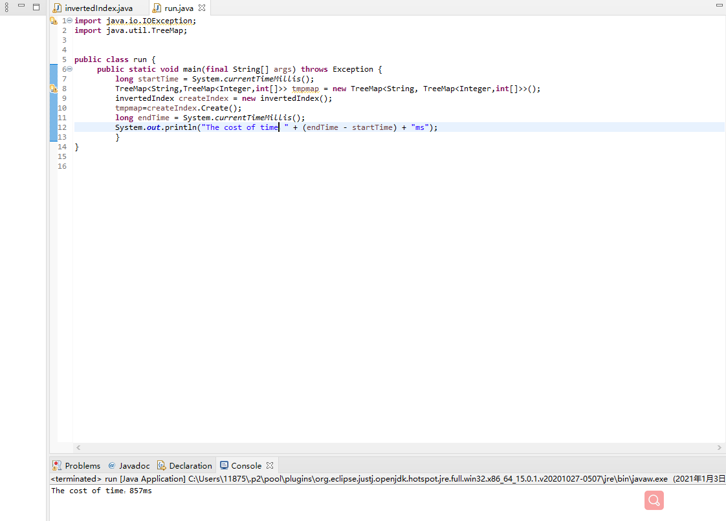
Index<10m
Compare the results with and without MapReduce

Slide 17
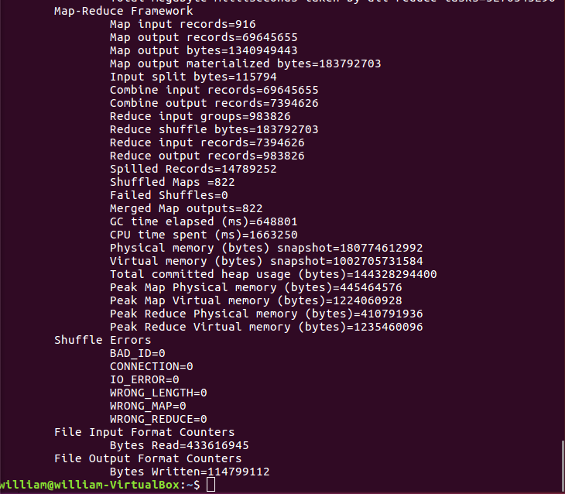
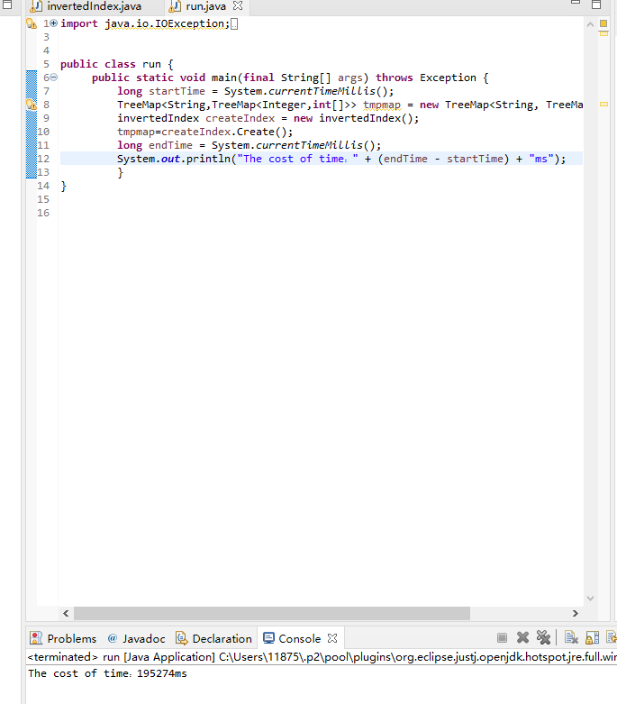
Index>200m
Compare the time with and without MapReduce

Slide 18
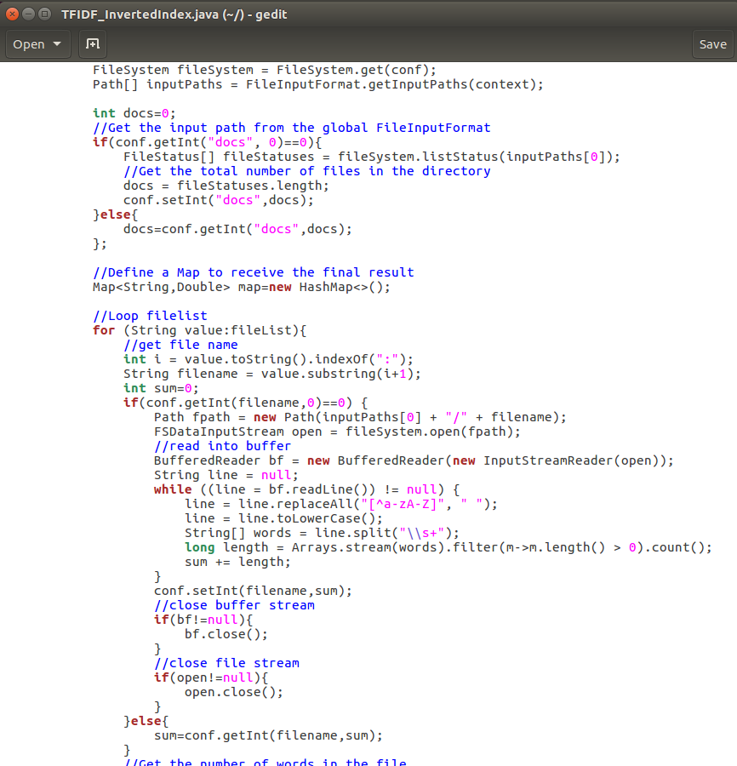
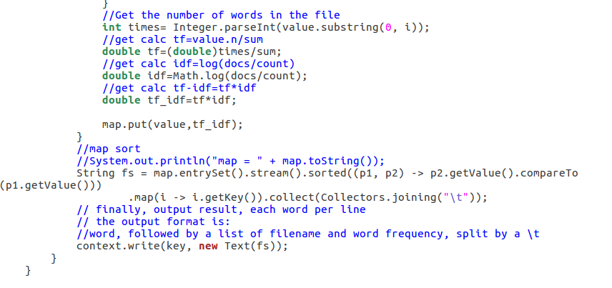
Ranking

Slide 19
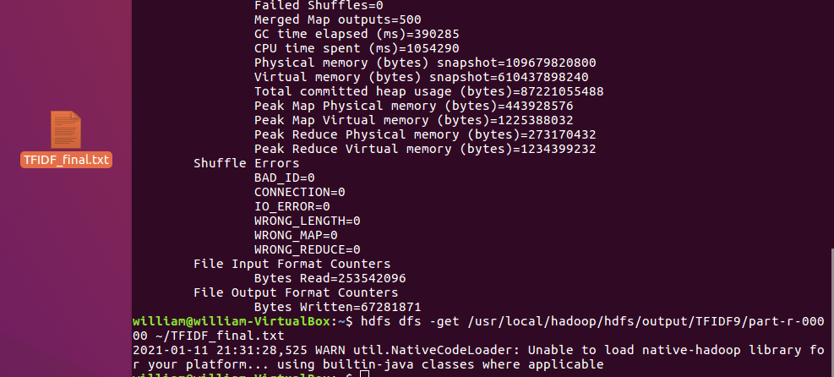
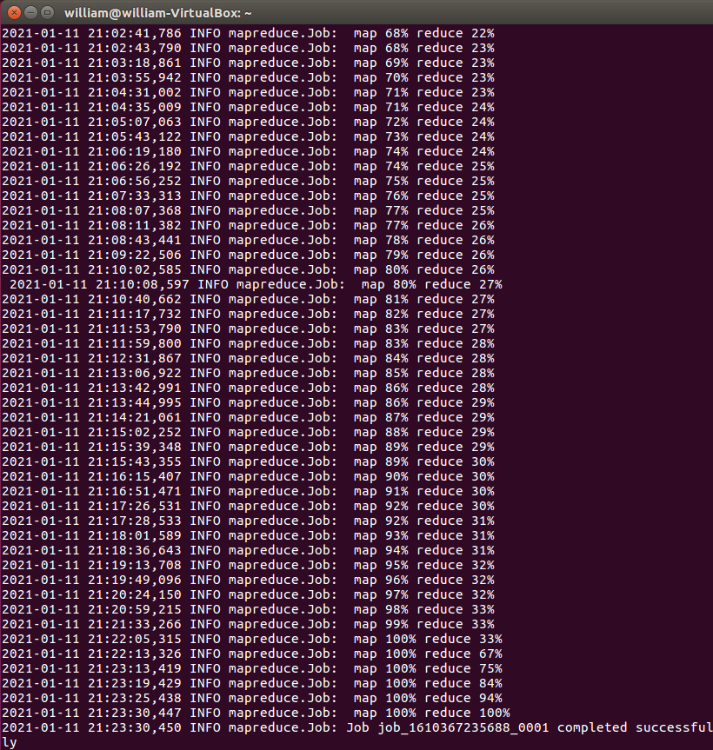
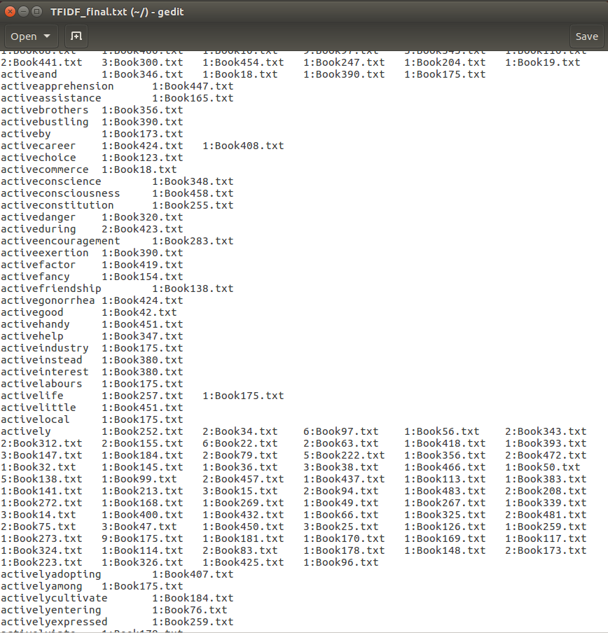
Ranking
Result

Slide 20
PART 03
Searching Interface

Slide 21
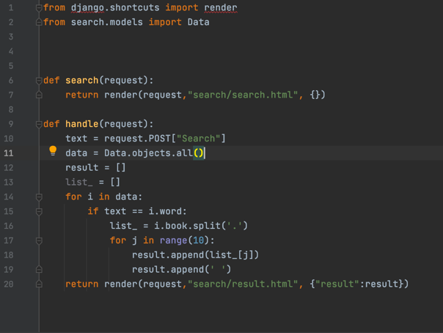
Searching Interface
We use Django and Python to help us create the MVT model.
We define two functions to allow the user to search our database.

Slide 22

Searching Interface
After the user press the search button, the handle function check whether the searching key word of the user appears in our database.

Slide 23

Searching Interface
If the word exists in our database, the website turns to the result page and show the appearance of the searching key word.

Slide 24
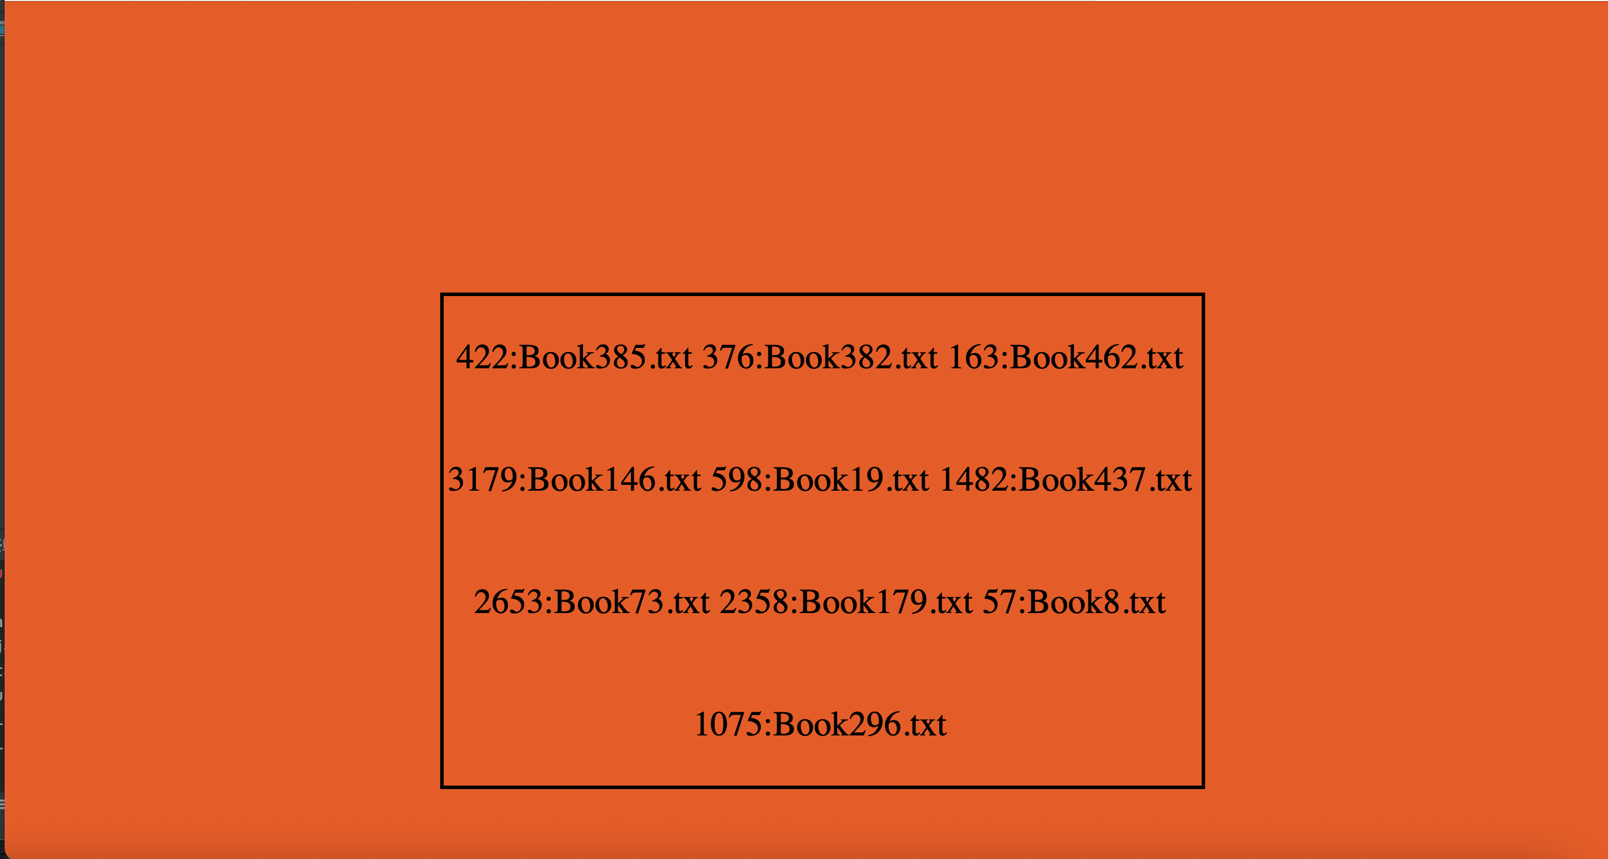
Searching Interface
Result

Slide 25
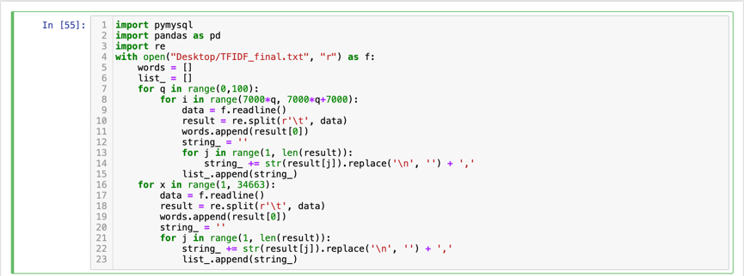
Searching Interface
Since our text file doesn't have list separator, we use Python to read and preprocess the dataset
By using the functions in Python, we can split the dataset by using the ‘\t’ sign, here we also add a comma behind each book name in order to make it convenience to help us divide the string to show the dataset to the user in a more obviously way.

Slide 26
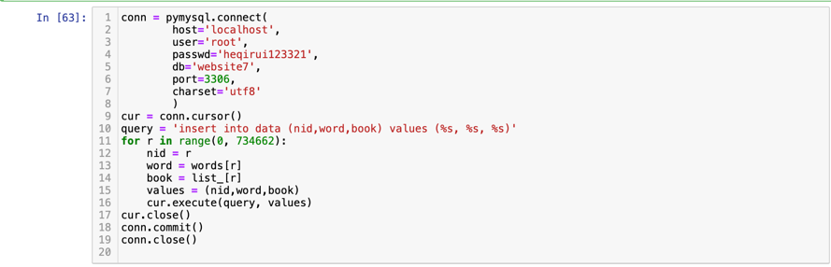
Searching Interface
Then we can use Python to import the data from the text file to the database.

Slide 27
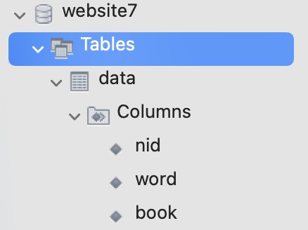
Searching Interface
After importing all the data into our database we can use the Mysql workbench to do a simple check.

Slide 28
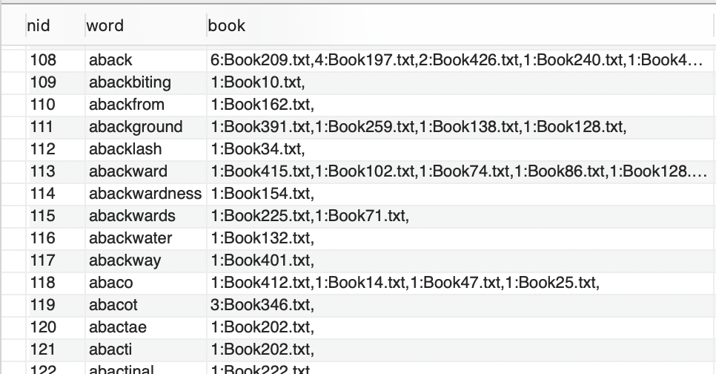
Searching Interface
After importing all the data into our database we can use the Mysql workbench to do a simple check.

Slide 29
Searching Interface
Then we can use the terminal of the Pycharm to connect to our localhost and get to the interface that allows the user to search the appearance of a word in our database like the previous slides.

Slide 30
THANKS FOR WATCHING

